Slide 1

PRESTIGE INSTITUE OF ENGINEERING MANAGEMENT AND RESEARCH, INDORE
Department of Computer Science Engineering
Internship on Artificial Intelligence
TOPIC: FAKE NEWS DETECTION
Submitted to:
Prof. Pritika Bahad
Prof. Pragya Ranka
Submitted by:
Karali Patil
Navalkhe Tejas
Nandini Kapure
Ritik Raghuwanshi

Slide 2
Content
Introduction
Motivation
Methodology
Result(Snapshots)
Future enhancements

Slide 3
Introduction
Fake news is false or misleading information presented as news. It often has the aim of damaging the reputation of a person or entity, or making money through advertising revenue.
Fake news can reduce the impact of real news by competing with it.

Slide 4
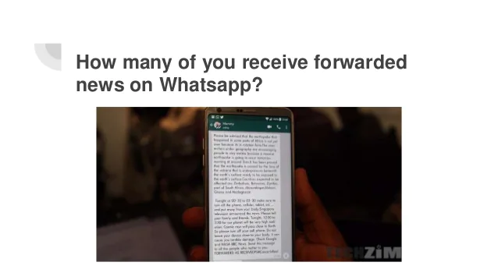
Motivation

Slide 5
Our Best Model
Droping NaN values.
A combination of title and author.
Removing Stop words with PorterStemmer function [It is a process of reducing a word to it's Root word]
Converting textual data to numerical data with TfidfVectorizer() function
Splitting dataset to training and test data using train_test_split function
Training a Model: Logistic Regression Model

Slide 6
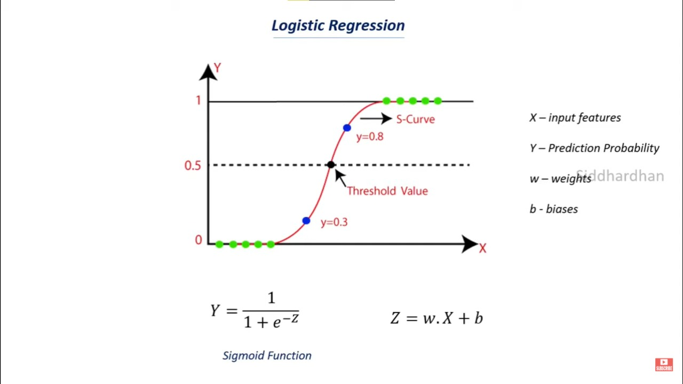
Methodology

Slide 7
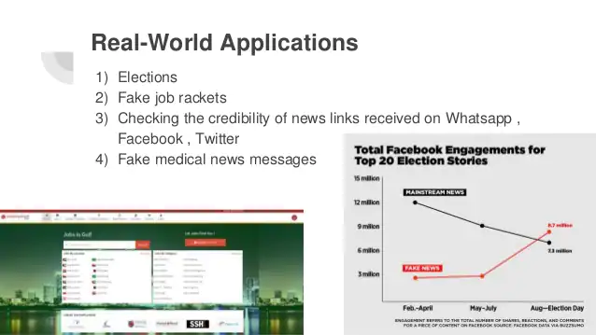

Slide 8
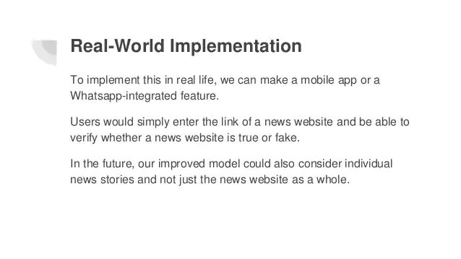

Slide 9
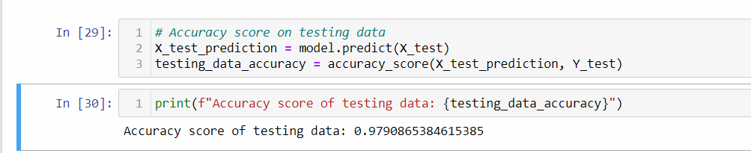
Result (Testing Accuracy)

Slide 10
Future enhancements
Integrating with Website.
Making API for other to use.

Slide 11


